Slide 1
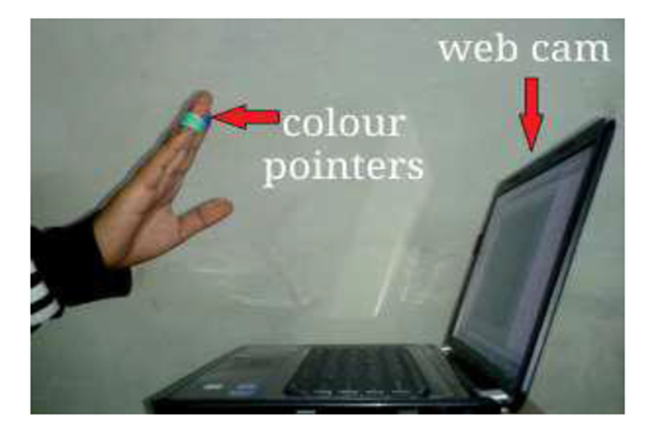
VIRTUAL MOUSE With FACE RECOGNITION Using Matlab
Guide : Shweta Dour
Group- 16
DISHA BHADAURIA -12103164
GAURAV UNIYAL-12103165
PARTH V PANCHAL -12103190

Slide 2
An Introduction
VIRTUAL MOUSE is an idea of implementing an adaptable, multi-functional navigation/interaction tool that overcomes physical barriers.
Ease of use is the foremost concern.
No need of hardware.
We can operate devices from a distant place.
We can interact with devices without any physical contact.

Slide 3
Proposed System Flow chart of Virtual Mouse
Camera
Capturing Frame
Pre Processing
Flipping and Extraction
Flipped Gray Scale Image
Subtraction
Median Filtering
Opening and Closing
Linking with Mouse
Thresholding
Bounding Box
Centroid Detection

Slide 4
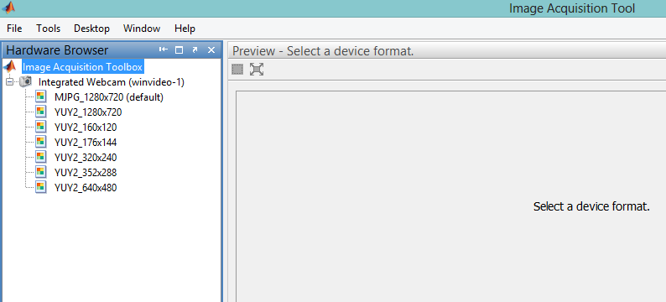
Capturing Frame

Slide 5
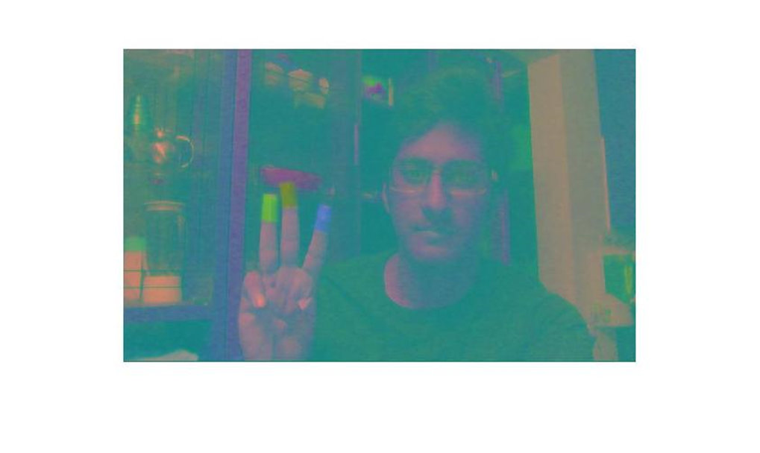
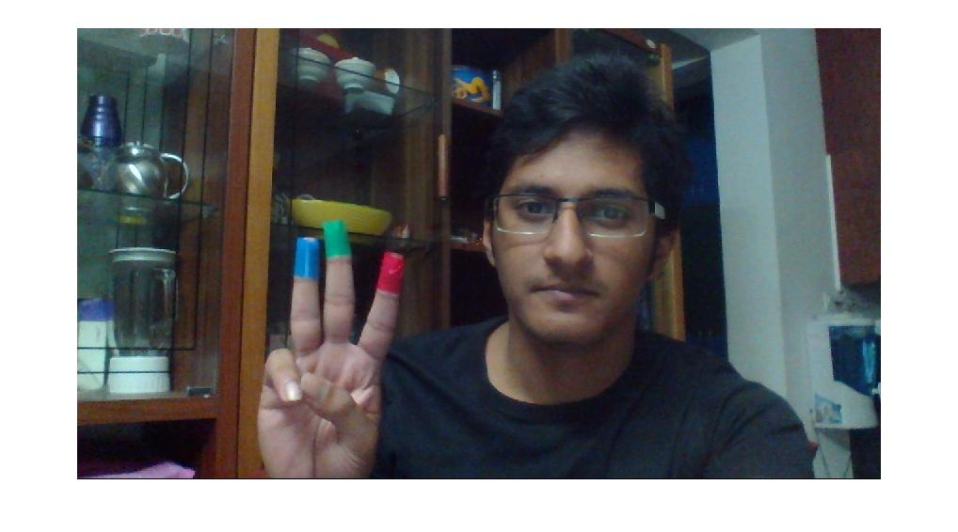


Pre-Processing

Slide 6
640 COLUMNS
480 ROWS
Because Matlab takes
the pixel values and
stores in form of
matrix
Rgb Image formed by 3 planes
3 Dimensional Matrix
3X 640X480(superimposed)
Why Matlab?

Slide 7
Flipping of Image
When the camera captures an image, it is inverted. This means that if we move the colour pointer towards the left, the image of the pointer moves towards the right and vice-versa.
It’s similar to an image obtained when we stand in front of a mirror (Left is detected as right and right is detected as left). To avoid this problem we need to flip the image.

Slide 8
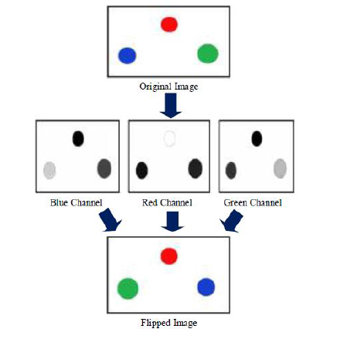
Flipping of Image
[9]

Slide 9

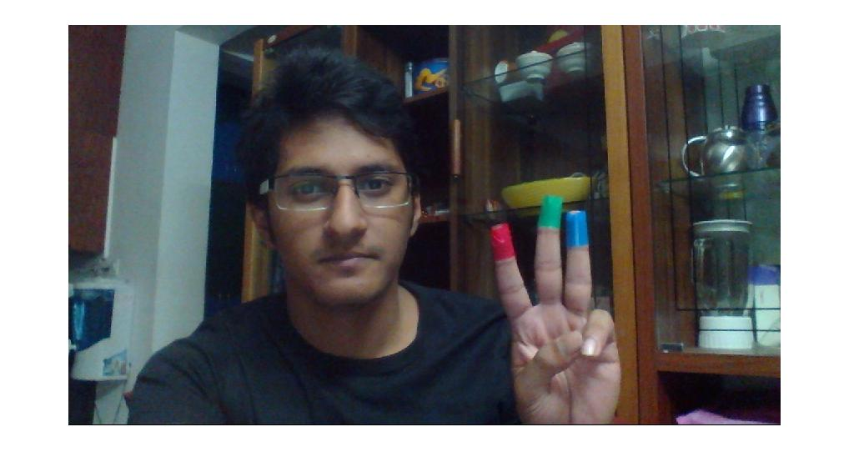
Flipping of Image
Captured image
Flipped Image

Slide 10
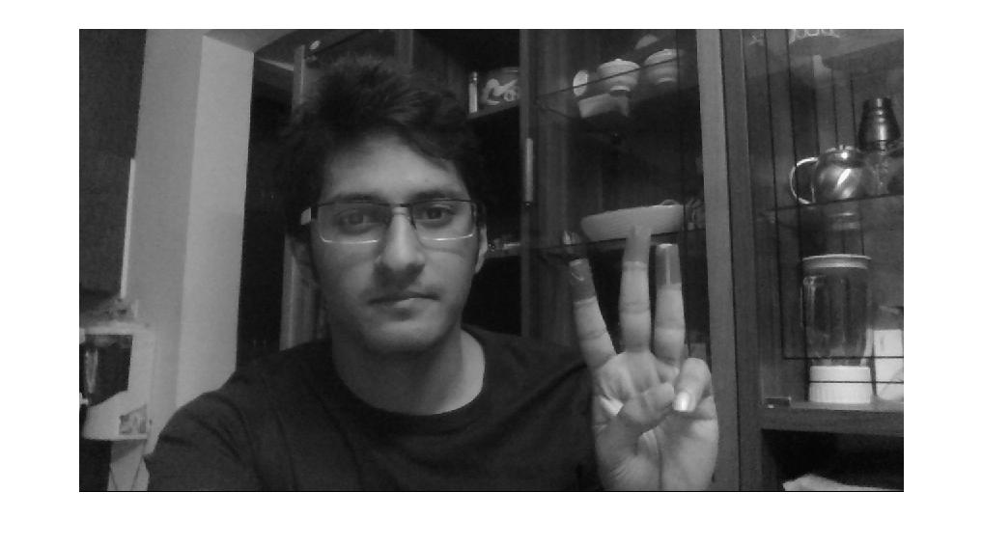

Gray Scale of Flipped image

Slide 11
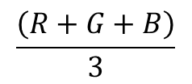
B
G
R
Gray
Rgb Image formed by 3 planes
3 Dimensional Matrix
3X 640X480 pixels
Gray image formed
By
$$\frac{\left(R+G+B\right)}{3}$$

Slide 12
Histogram Equalization
Histograms are the basis for numerous spatial domain processing techniques.
Its manipulation can be used effectively for image enhancement.
Histogram equalization automatically determines a transformation function that seeks to produce an output image that has a uniform histogram.
When automatic enhancement is desired, this is a good approach because the results from this technique are predictable and the method is simple to implement.

Slide 13
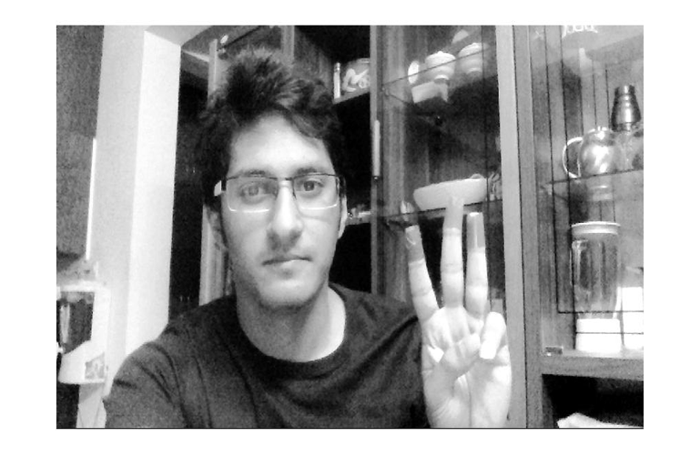
Histogram Equalization on Gray Scale Image
Histogram Equalization

Slide 14
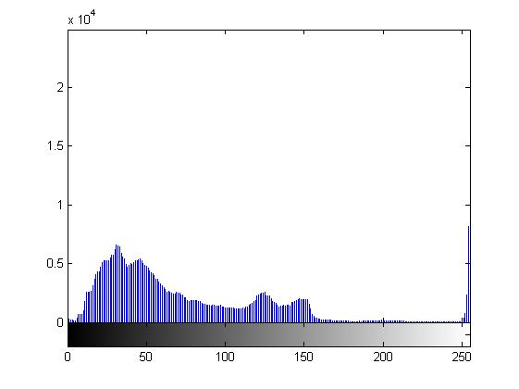
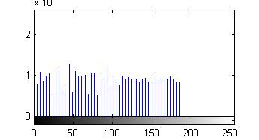
Comparison of pixels
Gray Scale
Histogram Equalization
Scale X-axis: Gray scale intensity Y-axis: Number of Pixels

Slide 15
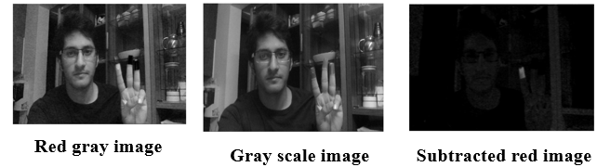
Subtraction of Images
In order to obtain only red coloured objects from an image we subtract the gray channel image from the red channel image by eliminating all other coloured objects except red coloured objects.
0 – Black 255- white

Slide 16
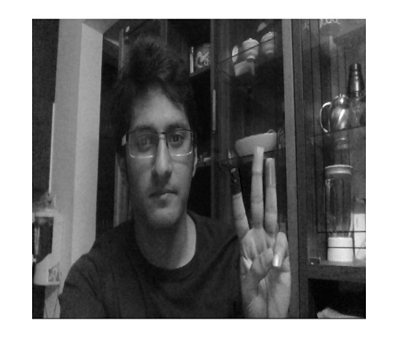
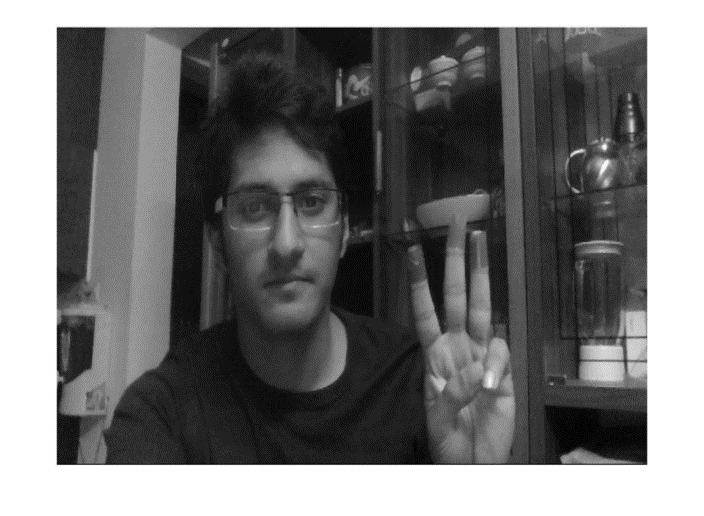
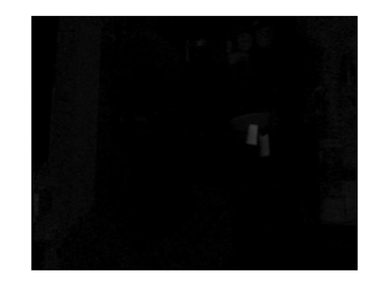
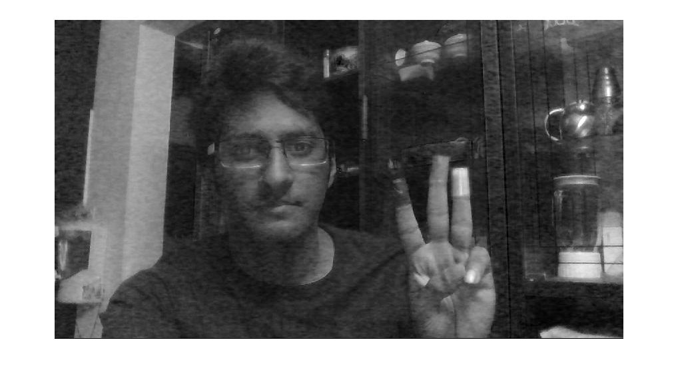

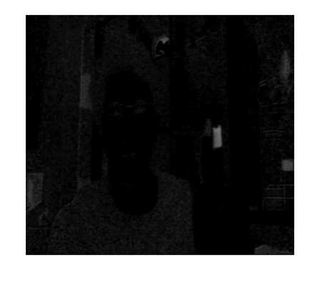
Subtraction of Images
Green gray image
Gray scale image
Subtracted green image
Blue gray image
Gray scale image
Subtracted Blue image

Slide 17
Median Filtering
The median filter is a nonlinear digital filtering technique, often used to remove noise. Such noise reduction is a typical pre-processing step to improve the results of later processing (for example, edge detection on an image).
Median filtering is very widely used in digital image processing because, under certain conditions, it preserves edges while removing noise.
The main idea of the median filter is to run through the signal entry by entry, replacing each entry with the median of neighbouring entries.

Slide 18
7 | 9 | 6
2 | 3 | 5
8 | 4 | 1
7 | 9 | 6
2 | 5 | 5
8 | 4 | 1
Before Median filtering by a 3X3 Matrix
After Median filtering by a 3X3 Matrix
1 | 2 | 3 | 4 | 5 | 6 | 7 | 8 | 9

Slide 19
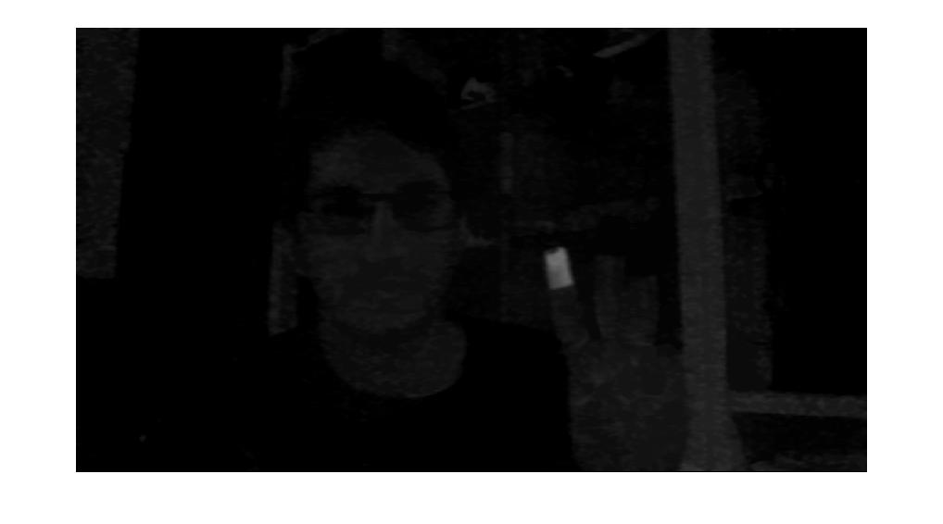
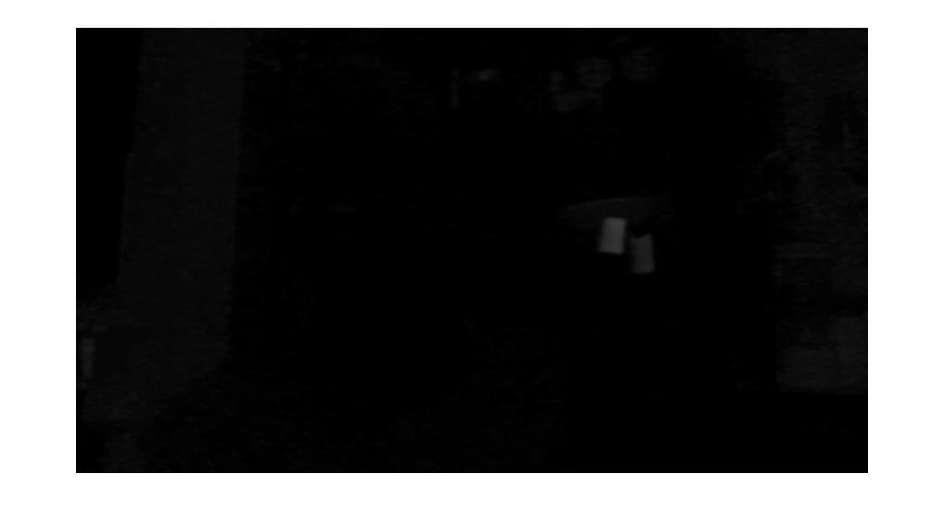
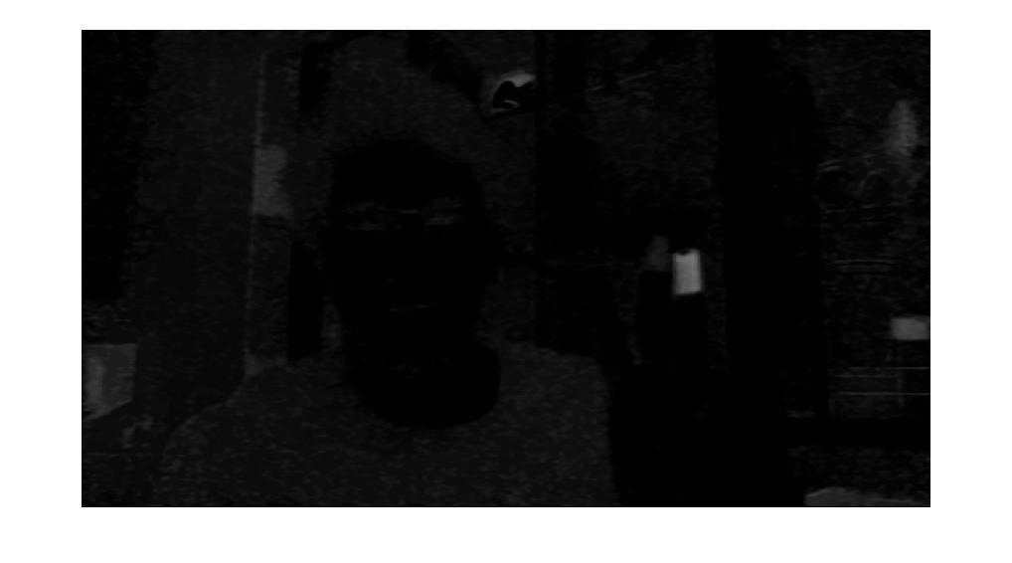
Median Filtering of Colored Tapes Red, Green ,Blue
Red Tape
Green Tape
Blue Tape

Slide 20
Opening & closing
For Edge correction.
Requires a structuring element.
In opening we are rotating this disc from inside of detected object.
In closing we repeat this process from outside.
And going to capture the next image and repeat this process again.
We are doing removal of small objects (or noise) and edge correction using Opening and Closing method with structural element as disk.

Slide 21
Opening
Closing
Opening and closing using disc of an irregular object

Slide 22
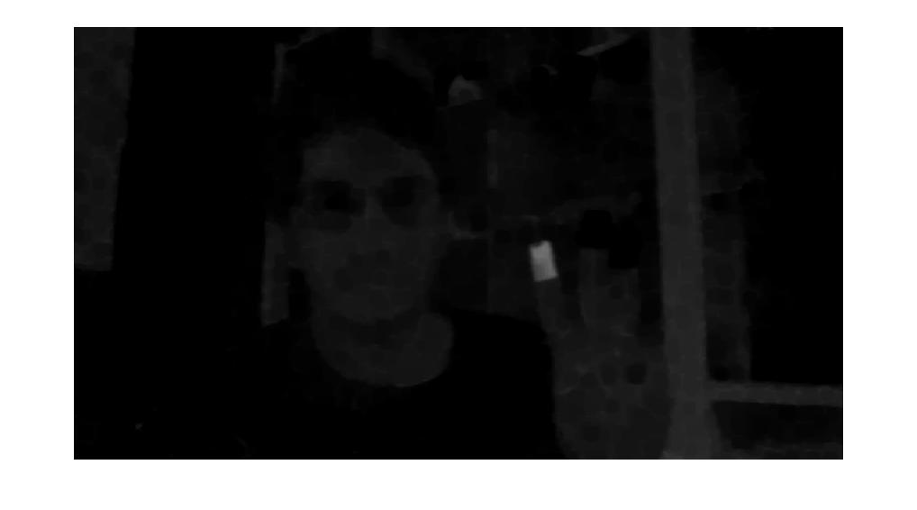
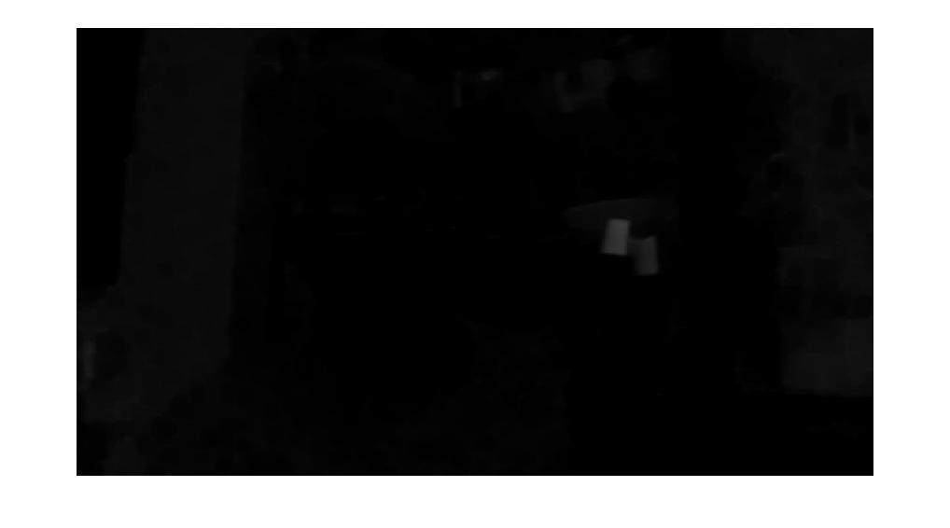

Open & Close disk Filtering of Colored Taped Red, Green ,Blue
Red Tape
Green Tape
Blue Tape

Slide 23
Thresholding
Thresholding is the simplest method of image segmentation.
From a grayscale image, thresholding can be used to create binary images.
The simplest thresholding methods replace each pixel in an image with a black pixel if the image intensity is less than some fixed constant, or a white pixel if the image intensity is greater than that constant.
This technique can be used to track the mouse pointer.

Slide 24
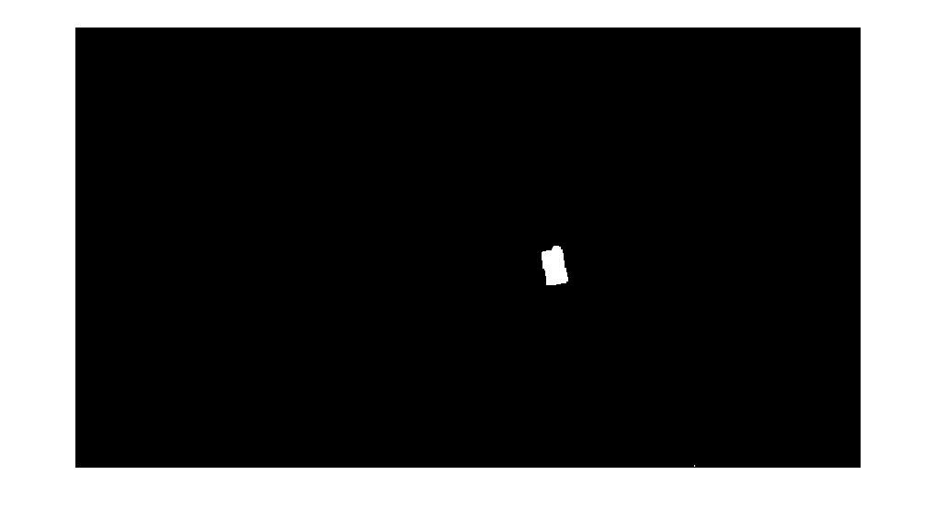
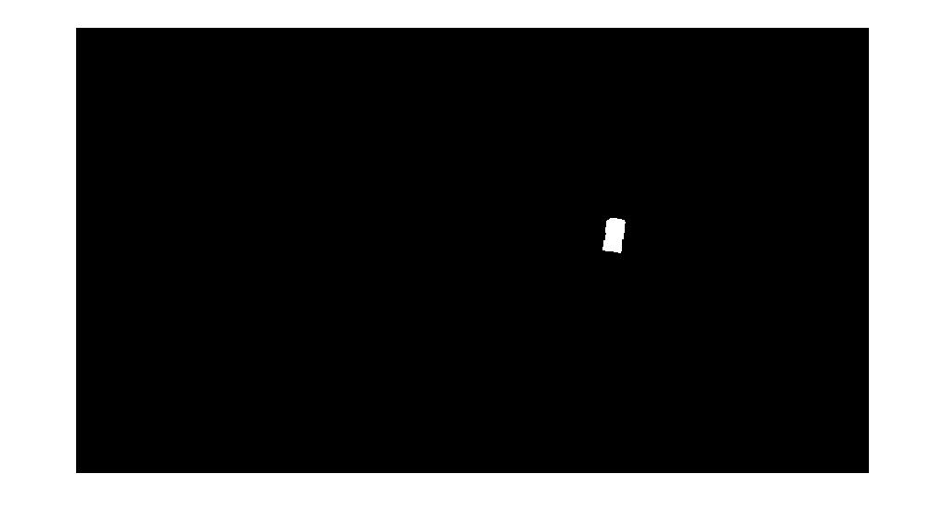
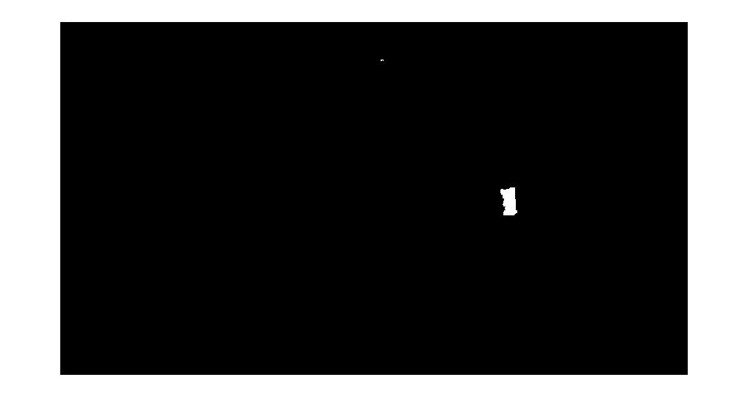
Thresholding on Colored tapes Red, Green, Blue
Red Tape
Green Tape
Blue Tape

Slide 25
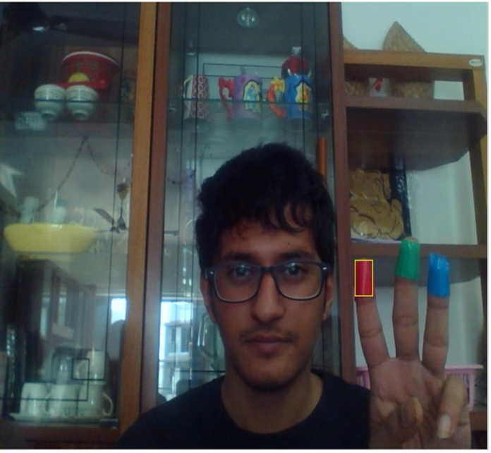
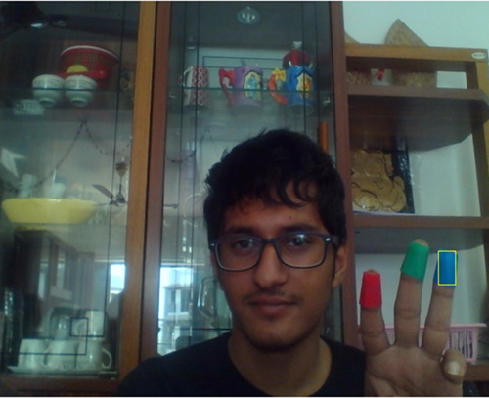
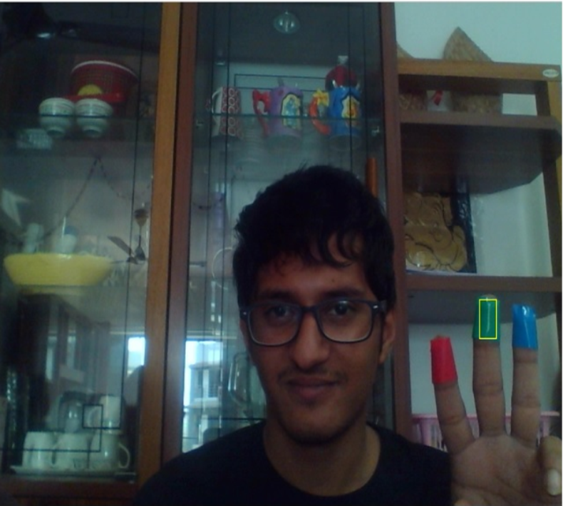
Bounding of Pointer Using Bounding Box
Red Tape
Green Tape
Blue Tape

Slide 26
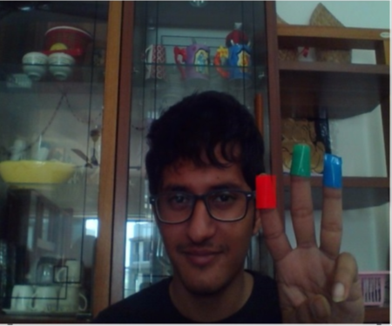
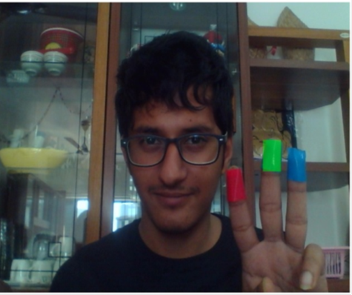
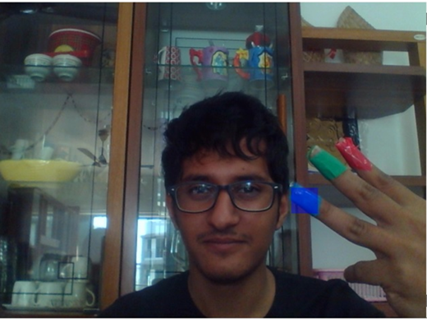
Differentiation of Bounding Box using colors
Red Tape
Green Tape
Blue Tape

Slide 27
Centroid Detection
For the user to control the mouse pointer it is necessary to determine a point whose coordinates can be sent to the cursor. With these co-ordinates, the system can control the cursor movement
The output of function is a matrix consisting of the X(horizontal) and Y (vertical) coordinates of the centroid.
These coordinates change with time as the object moves across the screen. Centroid of the image is detected, Its co-ordinates are located and stored in a Variable.

Slide 28
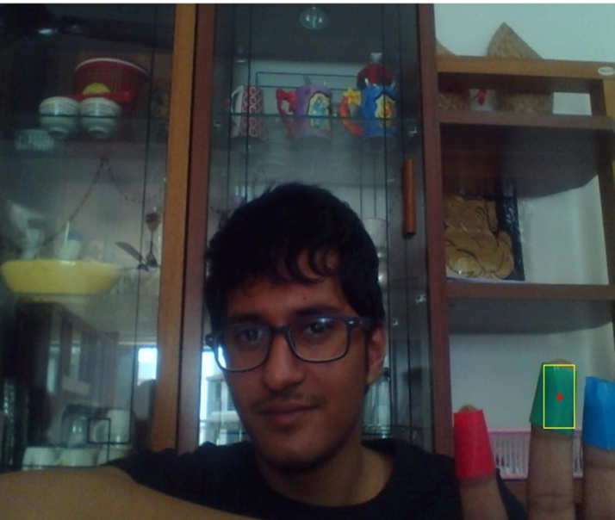
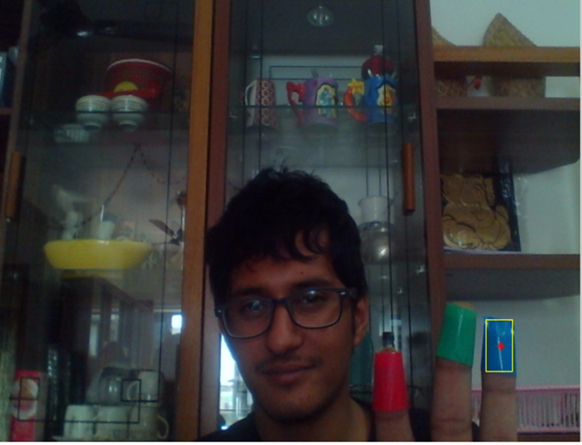
Centroid Detection of Colored Tapes
Red Tape
Green Tape
Blue Tape

Slide 29
Linking with Mouse
Once the coordinates has been determined, the mouse driver is accessed and the coordinates are sent to the cursor.
With these coordinates, the cursor places itself in the required position. It is assumed that the object moves continuously, each time a new centroid is determined and for each frame the cursor obtains a new position, thus creating an effect of tracking.
So as the user moves his hands across the field of view of the camera, the mouse moves proportionally across the screen.
A java object is created and it is linked with the mouse drivers. Based on the detection of other colours along with red the system performs the clicking events of the mouse.

Slide 30

Note-To cover full height and width of laptop screen
1366/640=2.13
766/480=1.9
M= java.awt.Robot;
if length(rbox(:,1))==1
x=Cr(1)*2.16-15;
y=Cr(2)*1.8-15;
M.mouseMove(x,y);
end
(0,0)
X
Deadspot
Y

Slide 31
Performing Clicking Actions
The control actions of the mouse are performed by controlling the flags associated with the mouse buttons.
JAVA is used to access these flags. The user has to perform hand gestures in order to create the control actions.
Due to the use of colour pointers, the computation time required is reduced.
Furthermore the system becomes resistant to background noise and low illumination conditions.
The detection of green and blue colours follows the same procedure discussed above.
M.mousePress(16);//performs clicking action i.e single click
M.mouseRelease(16);//performs releasing action after clicking
M.mousePress(4) // performs right click
M.mouseRelease(4)//releases right click

Slide 32
FACE RECOGNITION ALGORITHM
Create DATABASE
Covert RGB images to GRAY images
Matching with saved Eigen Faces of Database
Get MEAN of Gray images
EIGEN FACE=Eigen vector * Normalized Image
A=NORMALIZED images
=Gray image – Mean image
Get EIGEN VECTORS and EIGEN VALUES
C = COVARIANCE matrix of normalized images
= A’*A (A’ is transpose matrix)

Slide 33
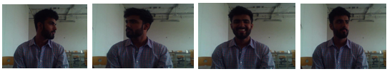
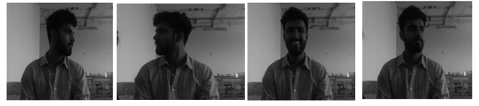
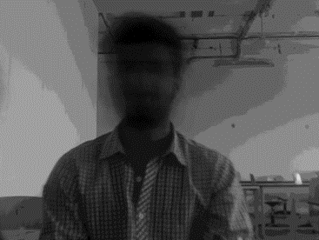
Create DATABASE (M=4)
Covert RGB images to GRAY images
Get MEAN of all Gray images

Slide 34
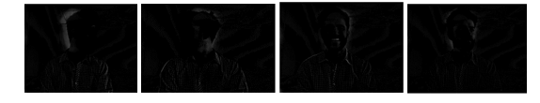
NORMALIZED images
COVARIANCE matrix of normalized images

Slide 35
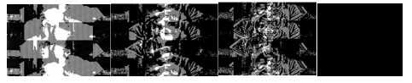
Get EIGEN VECTORS and EIGEN VALUES
Next we seek a set of eigen vectors, which best describes the distribution of the data.
EIGEN FACE
EIGEN FACES=Eigen vectors * Normalized Images

Slide 36
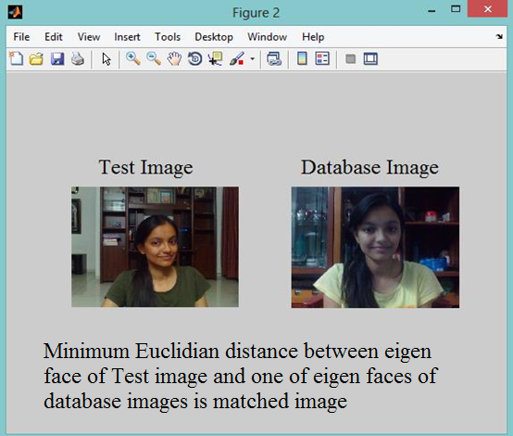
Face Recognition example

Slide 37
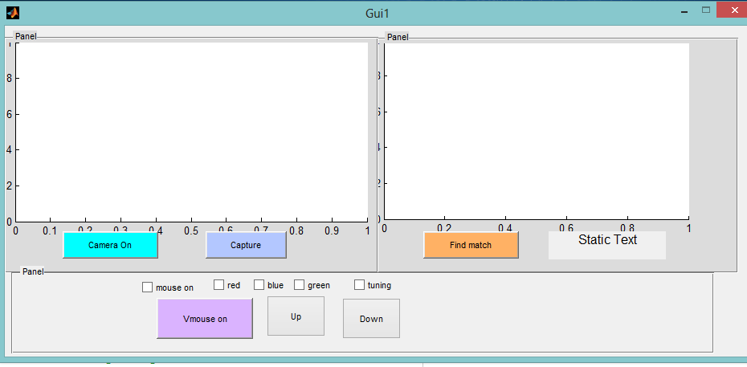
GUI Design Window

Slide 38
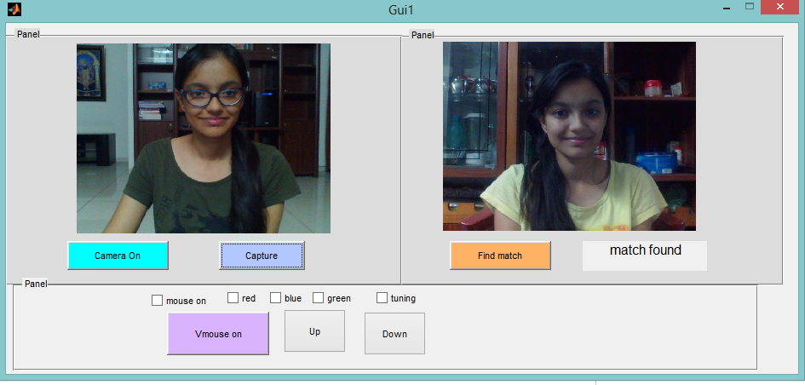
Working of GUI

Slide 39
Results
Threshold Range
Colour | Threshold Range
Red | 0.12-0.19
Green | 0.07-0.10
Blue | 0.15-0.20
Euclidian Distance Range
Euclidian Distance Range (For test image and database image of same person) | 1.2e17 – 3.5e18
Euclidian Distance Range (For test image and database image of different person) | 3.3e18 – 9.1e19

Slide 40
Conclusion
We are developing a system to control the mouse cursor
in real-time.
This system is based on computer vision algorithms and can do all mouse tasks.
However, it is difficult to get stable results because of the variety of lighting and the background colors .
This system could be useful in presentations and to reduce work space.
Features such as enlarging and shrinking windows, closing window, etc. by using the palm and multiple fingers can be developed in future.

Slide 41
Future Enhancement :
Expansion & Shrinking(Zoom in and Zoom out)or dragging.
A revolution in gaming.

Slide 42
PAPER PRESENTED
We have prepared and presented a research paper based on our project titled “COLOR TRACKING BASED VIRTUAL MOUSE” at “INTERNATIONAL CONFERENCE IN AUTOMATION IN INDUSTRIES (ICAI)” on 5 April, 2016. It was an International Conference at Om Engineering College, Junagadh, Gujarat. Our Paper Id: ICAI-16510 was published in ICAI JOURNAL (ISBN: 978-93-85016-99-8).
We won Best Paper Award based on the following judging criteria
1) Technical merit
2) Originality
3) Potential impact on the field
4) Clarity of the written paper
5) Quality of the oral or other presentation.

Slide 43
References
[1] Kamran Niyazi, Vikram Kumar, Swapnil Mahe and Swapnil Vyawahare Hojoon Park, “A Method For Controlling The Mouse Movement using a Real Time Camera”, in Brown University,Providence ,RI ,USA, Department of computer science, 2008.
[2] Seung Han, Jeon Yeong Mi, Jung Hye Kwon, Hwang-Kyu Yang, Byung Gook Lee "Vision Based hand tracking for Interaction" in Dept. of Visual Contents, Dongseo University 2008. 01. 29
[3]P .Vijaya Kumar,N.R.V.Praneeth and Sudheer.V "Hand And Finger Gesture Recognition System for Robotic Application" in International Journal of Computer Communication and Information System ( IJCCIS) – Vol2. No1. ISSN: 0976–1349 July – Dec 2010
[4] Kamran Niyazi, Vikram Kumar, Swapnil Mahe and Swapnil Vyawahare "Mouse Simulation Using Two Coloured Tapes" in International Journal of Information Sciences and Techniques (IJIST) Vol.2, No.2, March
[5] Shany Jophin, Sheethal M.S, Priya Philip, T M Bhruguram "Gesture Based Interface Using Motion and Image Comparison" in International Journal of Advanced Information Technology (IJAIT) Vol. 2, No.3, June 2012
[6] Pravin R Futane, Dr. R. V. Dharaskar and Dr. V. M. Thakare “Cursor Controlling of Computer System through Gestures" in International Journal of Innovative Research in Computer and Communication Engineering Vol. 1, Issue 10, December 2013
[7] Uma Sahu, Ditty Varghese, Gayatri Gole, Melanie Fernandes, Pratiksha Mishra "Hand Cursor Implementation Using Image Processing & Sixth Sense Technology" in International Journal of Infinite Innovations in Technology Volume-I Issue-III 2012-2013 January
[8] Abhik Banerjee, Abhirup Ghosh, Koustuvmoni Bharadwaj, Hemanta Saikia "Mouse Control using a Web Camera based on Colour Detection" in International Journal of Computer Trends and Technology (IJCTT) – volume 9 number 1– Mar 2014
[9] Suresh DS, Bhavana ,"Virtual Mouse Implementation using Color Pointer Detection" in International Journal of Research Studies in Science, Engineering and Technology Volume 1, Issue 5, August 2014, PP 23-32
[10 ]Jayaprakash Nagaruru, V.Ravi Kumar "Implementation of Cognitive and Virtual Mouse Pointer Control" in Journal of Electronics and Communication Engineering (IOSR-JECE) ISSN: 2278-2834,p- ISSN: 2278- 8735.Volume 9, Issue 5, Ver. III (Sep - Oct. 2014), PP 44-49

Slide 44
References
[11] Hardik Dinesh Patil, Bhuvaneshwar Annladasula, Viraj Birajdar, Amol Ambodhare "Human Computer Interaction Where Controlling Computer and Applications Through Image Processing and Voice Recognition" in International Journal of Advanced Research in Computer Science & Technology Vol. 2, Issue 4
[12] Ptabhakar Jha, Gulshan Sharma, Fiyanshu Dodia,Umesh Prajapati and Prof. Sandip Dawda "Virtual Mouse using Colour Tracker" in International Journal of Innovative and Emerging Research in Engineering Volume 2, Issue 2, 2015
[13] Ankush Chaudhary, Ashish Kumar Sharma, Jyoti Dalal Leena Choukiker4 "Mouse control using Hand Gestures" in Journal of Emerging Technologies and Innovative Research March 2015, Volume 2, Issue 3 Volume-I Issue-III 2012-2013 January
[14] Sai Maheswara ,Reddy,Manda Damodhar, V Raja Paluri project report "A Robust Implementation of Virtual Mouse Using Webcam" in Rajiv Gandhi University of Knowledge Technologies.
[15] Noor Shaker, Abou Zliekha "Real-time Finger Tracking for Interaction" Damascus University.
[16] Ragini.S.Dubey, “Face Recognition Using Eigenvectors From Principal component Analysis” in International Enginering Journal For Research & Development Volume 2, Issue 2.
[17] Matthew A. Turk and Alex P. Pentland, “Face Recognition using Eigenfaces”, in Massachusetts Institutes of Technology CVPR’91, pp. 586-591 IEEE Computer Society, 1991.
[18] Prabhakar Telagarapu,Gulivindala Suresh,J. Venkata Suman, Lalitha “A Comprehensive Methodological Analysis of Eigen Face Recognition and Reconstruction”, in International Journal of Computer Theory and Engineering, Vol. 4, No. 1, February 2012.
[19] Kandla Arora, “Real Time Application of Face Recognition Concept” in International Journal of Soft Computing and Engineering (IJSCE) ISSN: 2231-2307, Volume-2, Issue-5, November 2012.
[20] Prof. B.S Patil ,Prof. A.R Yardi ,“ Real Time Face Recognition System Using Eigen Faces” in International Journal Of Electronics And Communication Engineering & Technology Volume 4, Issue 2, March – April, 2013, pp. 72-79.
[21] Rajib Saha, Debotosh Bhattacharjee,“Face Recognition Using Eigenfaces” in International Journal of Emerging Technology and Advanced Engineering , Volume 3, Issue 5, May 2013.

Slide 45

References
[22] Ayushi Gupta, Ekta Sharma, Neha Sachan and Neha Tiwar, “Door Lock System through Face Recognition Using MATLAB” in International Journal of Scientific Research in Computer Science and Engineering Volume 1, Issue 3, June 2013.
[23] Farooq Ahmad Bhat, Mohd Arif Wani, “Improved Face Recognition Algorithm Using Eigen Faces”, in International Journal of Advanced Research in Computer Science and Software Engineering Volume 3, Issue 12, December 2013.
[24] Shrutika Yawale, Mayuri Patil, Reshma Adagale, Shweta Pinjarkar “Face Recognition using Eigen Application”, in International Journal for Innovative Research in Science & Technology Volume 1 ,Issue 6.
Reference Book
Digital Image Processing by Rafael C. Gonzalez Richard E. Woods
Reference Websites
http://stackoverfow.com/
http://www.dreamincode.net/ http://msdn.microsoft.com/
http://www.technical-recipes.com/ http://www.intorobotics.com/
http://www.progcode.in/

